Slide 1
Video URL
Artemis_enhancement proposal.mp4

Slide 2


Artemis
CISC-322 Group 14
Adrian Chu* | 18anhc@queensu.ca
Alex Baldassare | 18cab16@queensu.ca
Randy Bornstein* | 18rjb10@queensu.ca
Jake Halay** | 15jmh9@queensu.ca
Kashish Khandelwal | 20kmk3@queensu.ca
*Presenters **Group Leader
Notes:
Adrian

Slide 3
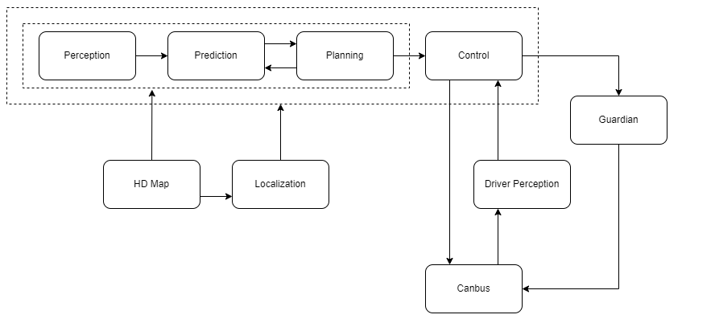
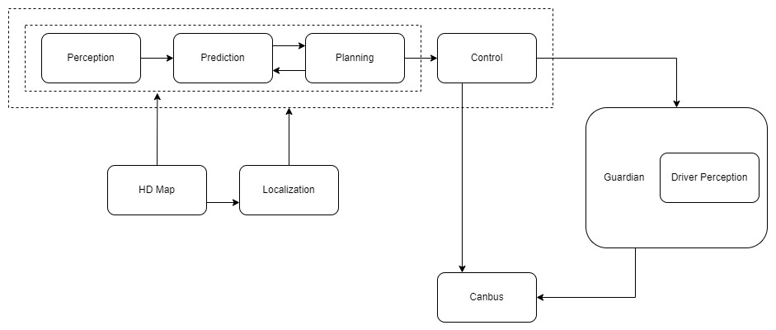
Proposed Enhancement
Driver monitoring module
How it works
Implementation 1
Independent module
Implementation 2
Guardian Submodule
Notes:
Randy

Slide 4
Non-Functional Requirements
*Reliability
Availability
Performance
Security
…
Notes:
Adrian

Slide 5

Impacted Modules
Affected modules
Monitor
HMI
Guardian
Prediction
Planning
Impacts on Monitor & HMI
Impacts on Guardian
Impacts on Prediction and Planning
Notes:
Randy

Slide 6

SAAAAAAAAAAAAAAAAAAAAAAAAAAAAAAAAAM aka SAAM
Stakeholders
Customers/Drivers
Suppliers
Important Non-Functional Requirements
Customers/Drivers -> Accuracy, Maintainability, Cost
Suppliers -> Maintainability, Reusability, Manageability
Impacts on Implementation
Independent module vs Guardian Submodule
Chosen Implementation
Notes:
Randy

Slide 7
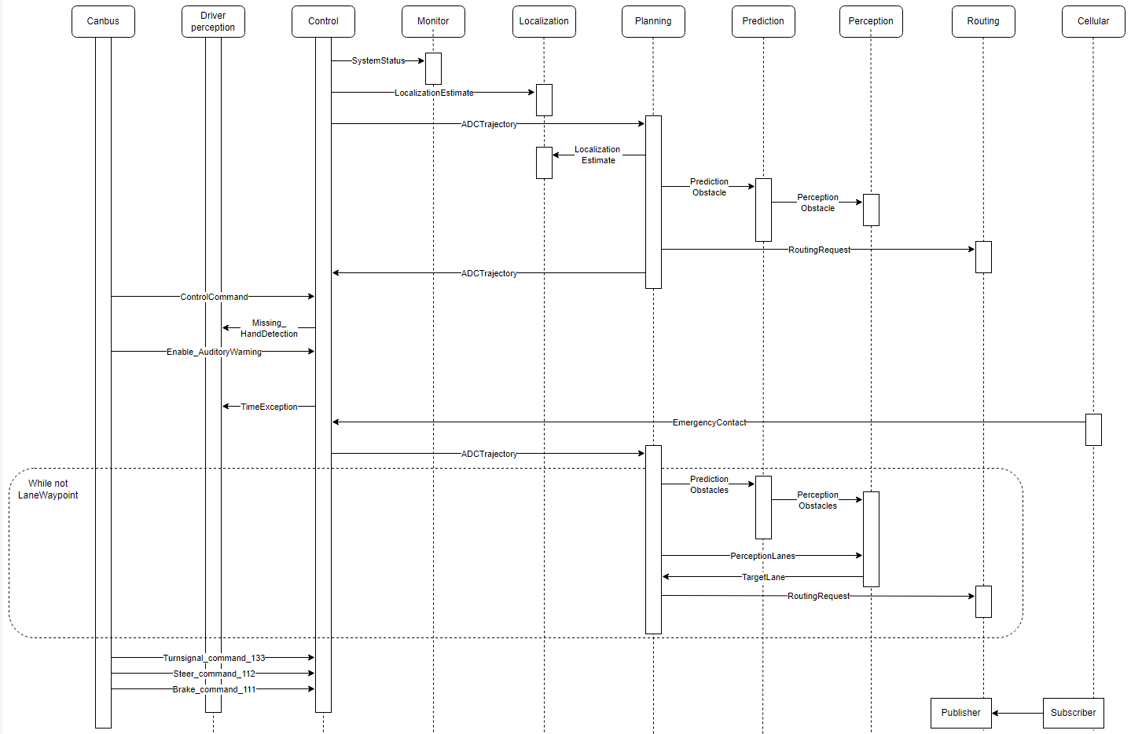
Use case
Car moves to the shoulder of the road after no hands are on the wheel for an extended duration
Notes:
Randy

Slide 8
Effects and Risks/Drawbacks
Risks =/= Drawbacks
Risks: unwanted outcomes that may occur under certain circumstances but not always
e.g., hardware failure, false alerts, software failures etc.
Drawbacks: factual and unavoidable (due to concept and design)
e.g., different vehicle and traffic norms/policies that may restrict functionality
Notes:
Adrian

Slide 9
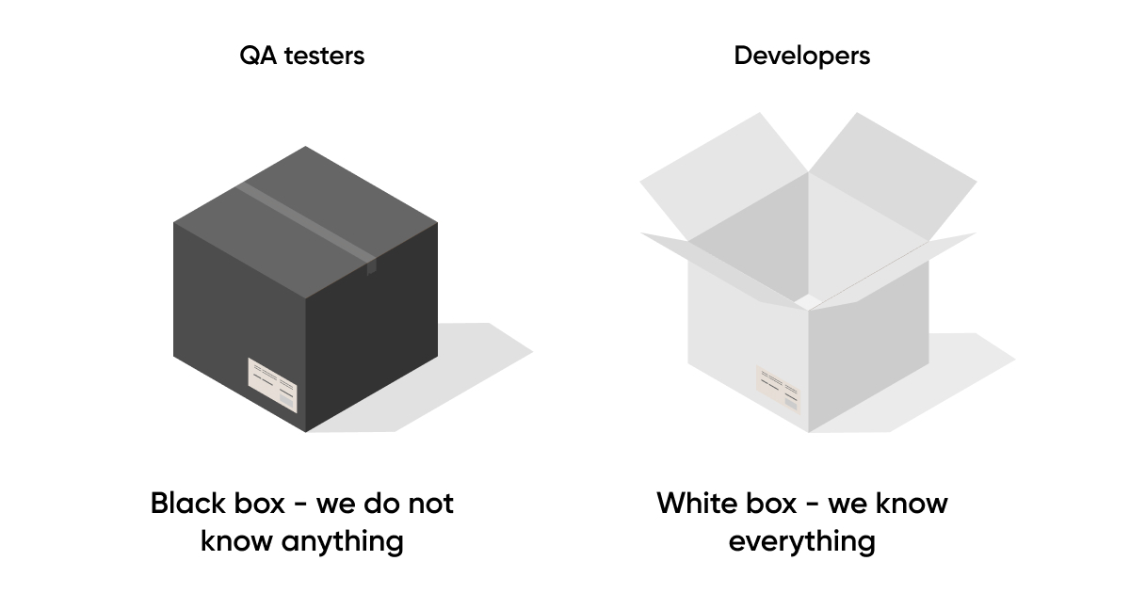
Testing
White-box vs black-box testing
Notes:
Adrian

Slide 10
Testing
1. General test cases (white-box testing)
Response time for activating emergency protocols
Detection time for hands off the steering wheel
Force/pressure required on the steering wheel
→ Outcomes that we expect/know of
Notes:
Adrian

Slide 11
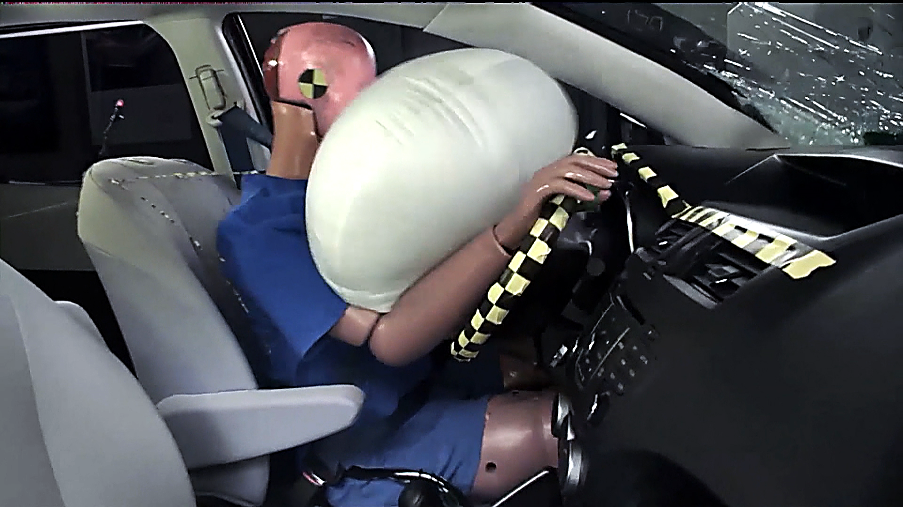
Testing
2. Testing for risks (black-box testing)
Hardware conditions
Software compatibility
Antivirus and security
→ Outcomes that we need to find out through testing
Notes:
Adrian

Slide 12
Lessons learned
Importance of risk assessment
Effects on stakeholders and the system as a whole
How NFRs align with the enhancement’s goals
Why black-box testing is (sometimes) more important
Notes:
Adrian

Slide 13

-Thank you-

